Slide 1
Data Transformations in R

Slide 2
What are Transformations?
Code that changes the shape of your data

Slide 3
Transpose
t(dataFrame)
Student | Name | Grade
1 | Terry | A
2 | Tina | B
3 | Tom | A
Student | 1 | 2 | 3
Name | Terry | Tina | Tom
Grade | A | B | A

Slide 4
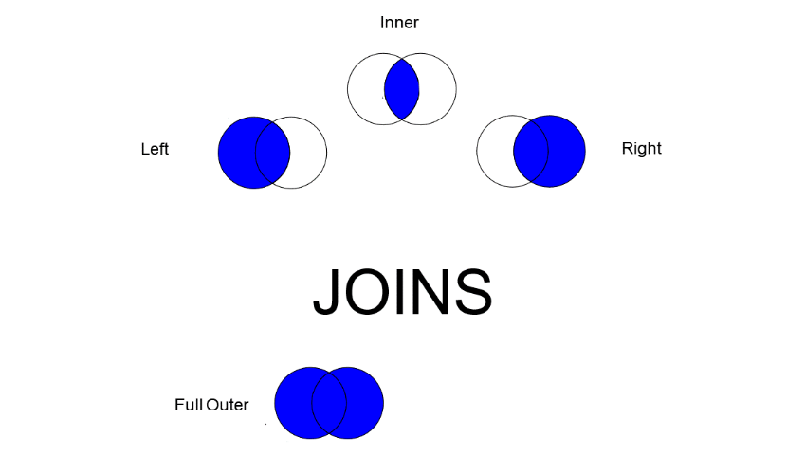
Types of Merges
Like JOIN in SQL

Slide 5
Merge
NewDataFrame = merge(data1, data2, by=c(“ID”))
Student | Name | Grade
1 | Terry | A
2 | Tina | B
3 | Tom | A
Student | Name | Grade | Class
1 | Terry | A | Stats
2 | Tina | B | R
3 | Tom | A | Python
Student | Class
1 | Stats
2 | R
3 | Python

Slide 6
Append – Add Rows
Must have the same name and number of columns
rbind(data1, data2)
Student | Name | Grade
1 | Terry | A
2 | Tina | B
3 | Tom | A
Student | Name | Grade
1 | Terry | A
2 | Tina | B
3 | Tom | A
4 | Gina | A
5 | Reggie | B
6 | Rufus | C
Student | Name | Grade
4 | Gina | A
5 | Reggie | B
6 | Rufus | C

